Slide 1


Delivering Scotland’s Air Departure Tax
Welcome and introduction

Slide 2
ADT timeline
March 2016: Powers devolved to Scottish Parliament via the Scotland Act 2016
June 2017: Scottish Parliament passed the Air Departure Tax (Scotland) Act
November 2017: Introduction of ADT deferred beyond 1 April 2018
May 2021: SNP manifesto states commitment to finding a solution to the H&I exemption and implementing ADT.
June 2025: High-level principles of ADT published
January 2026: Implementation of ADT announced at the Scottish Budget
April 2027: ADT introduced and APD turned off in Scotland

Slide 3
Outline of ADT Proposals
The Scottish Government has developed a revised Highlands and Islands exemption for ADT that complies with the UK Government's Subsidy Control regime and protects regional aviation connectivity.
ADT will become operational in Scotland from 1 April 2027 and APD ‘turned off’ in Scotland from that date.
Revenue Scotland will be responsible for the collection and management of ADT, with HMRC retaining responsibility for APD in the rest of the UK.
ADT rates and bands will match those of UK-wide APD for the first year of operation (1 April 2027 – 31 March 2028) to provide certainty and smooth the transition between taxes.
From 1 April 2028, there will be a further Jet Supplement as part of ADT, in addition to the UK Government’s planned increases in private jet taxation under APD.

Slide 4
What does the consultation cover?
Composed of three substantive sections:
    The proposed Highlands and Islands exemption
    Private jet taxation
    Operational and future policy considerations
The consultation will run for eight weeks, closing on 26 March 2026.
Pre-election period then begins where we will undertake the consultation response analysis.

Slide 5
The Highlands & Islands Exemption
APD Exemption:
All flights from H&I airports are exempt, no matter their destination (including connecting flights).
Could fly business class from H&I to any destination across the globe and pay no tax on the entire journey.
ADT Exemption:
Removes international flights from the exemption, making them liable to ADT. (Note: this includes connecting flights to international destinations – the entire journey will be taxable, based on the final destination)
Retains the tax-exempt status of flights from H&I airports to the rest of the UK (including connecting flights)
Extends the exemption to outward legs of flights from other Scottish airports to H&I airports

Slide 6
Practical Implications
Examples:
Route | APD | ADT
Inverness – Heathrow | Exempt | Exempt
Inverness – Heathrow – Dubai | Exempt* | Taxable*
Glasgow – Dubai | Taxable | Taxable
Inverness – Amsterdam | Exempt | Taxable
Aberdeen – Sumburgh | Taxable | Exempt
Sumburgh – Aberdeen | Exempt | Exempt
Edinburgh – Kirkwall – Sumburgh | Taxable | Exempt**
Sumburgh – Kirkwall – Edinburgh | Exempt** | Exempt**
* When travelling on connecting flights.
** Whether travelling on connecting flights or individual tickets for each leg.

Slide 7
Private Jet Supplement
Scottish Ministers have signalled an intention to explore higher rates of ADT on passengers travelling by private jet.
This is in line with SG’s progressive approach to taxation and the polluter pays principle.
Matching all UK APD rates and bands for first year of operation, including private jets.
Private Jet Supplement will apply from April 2028 onwards with rates set out at the 2027-28 Scottish Budget
Consultation seeks to gather views and evidence of potential impact of this measure.
(Note: it is proposed that passengers travelling by private jet are not eligible for the new H&I exemption)

Slide 8
Future policy considerations
The Scottish Government published high-level principles of ADT on 25 June 2025 which provide the long-term framework against which policy proposals must be assessed:
    Generate stable revenues to fund public services in Scotland;
    Protect Highlands and Islands aviation connectivity;
    Promote Scotland’s connectivity and growth objectives; and
    Support our net zero ambitions.
To support the preparation of ADT rates and bands for 2028-29 and future years, the consultation invites views and evidence on the role of ADT to support its high-level principles and broader priorities as a Government, as set out in its 2025-26 Programme for Government.

Slide 9
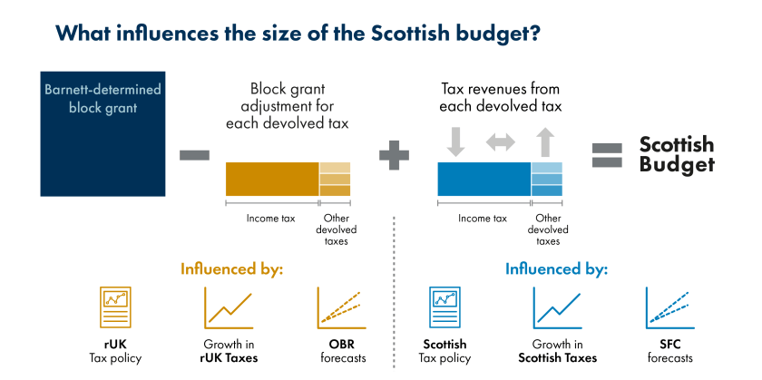
Block Grant Adjustment

Slide 10
Forward look
Date | Event
29 January | Consultation opens
February | Ministerial roundtables
26 March | Consultation closes and pre-election period begins
7 May | Scottish Parliament election
4 September (tbc) | End of Scottish Parliament summer recess
November (tbc) | UK Autumn Budget
December (tbc) | 2027-28 Scottish Budget
1 April 2027 | ADT commences

Slide 11
Close

